Slide 1

Optimal coordination of deloaded PV and battery energy storage system for frequency stability: A two-stage methodology with cost-performance tradeoff.
Presented By
Md. Nazmul Alam Munna
Roll: 1024062304
EEE 6003: Solar Photovoltaic Systems
April 2025 Semester

Slide 2


Multilayer Graphene-Based Hybrid
Broadband Optical Modulator
Presented By
1024062304 Md. Nazmul Alam Munna

Slide 3
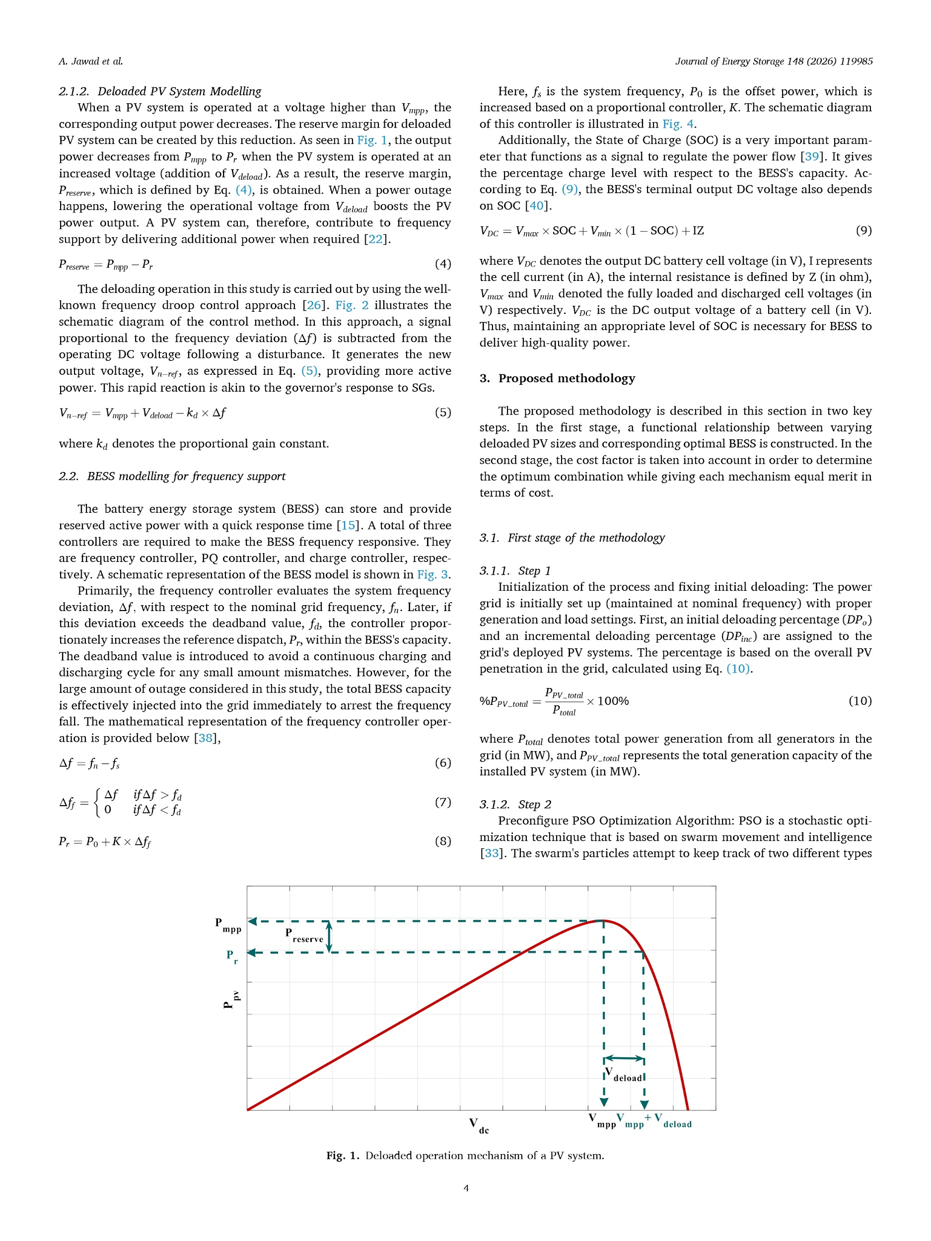
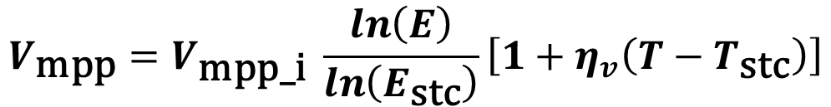
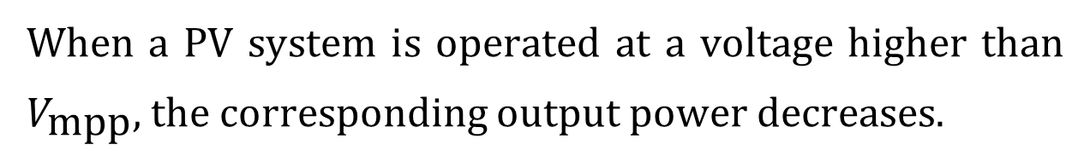
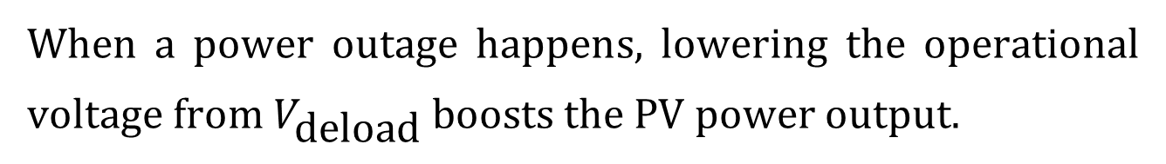

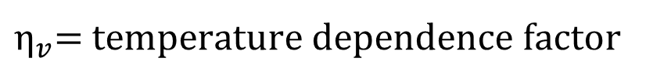
PV System Modelling
$$V_{\text{mpp}}=V_{\text{mpp}\text{_}\text{i}} \frac{\ln\left(E\right)}{\ln\left(E_{\text{stc}}\right)}\left[1+η_{v}\left(T−T_{\text{stc}}\right)\right]$$
$$V_{\text{mpp}\text{_}\text{i}}=V_{\text{stc}} \text{defined} \text{by} \text{PV} \text{module} \text{manufacturer}$$
$η_{v}$= temperature dependence factor
When a PV system is operated at a voltage higher than $V_{\text{mpp}},$ the corresponding output power decreases.
$$P_{\text{reserve}}=P_{\text{mpp}}−P_{r}$$
Fig. Deloaded operation mechanism of a PV system.
When a power outage happens, lowering the operational voltage from $V_{\text{deload}}$ boosts the PV power output.
2

Slide 4
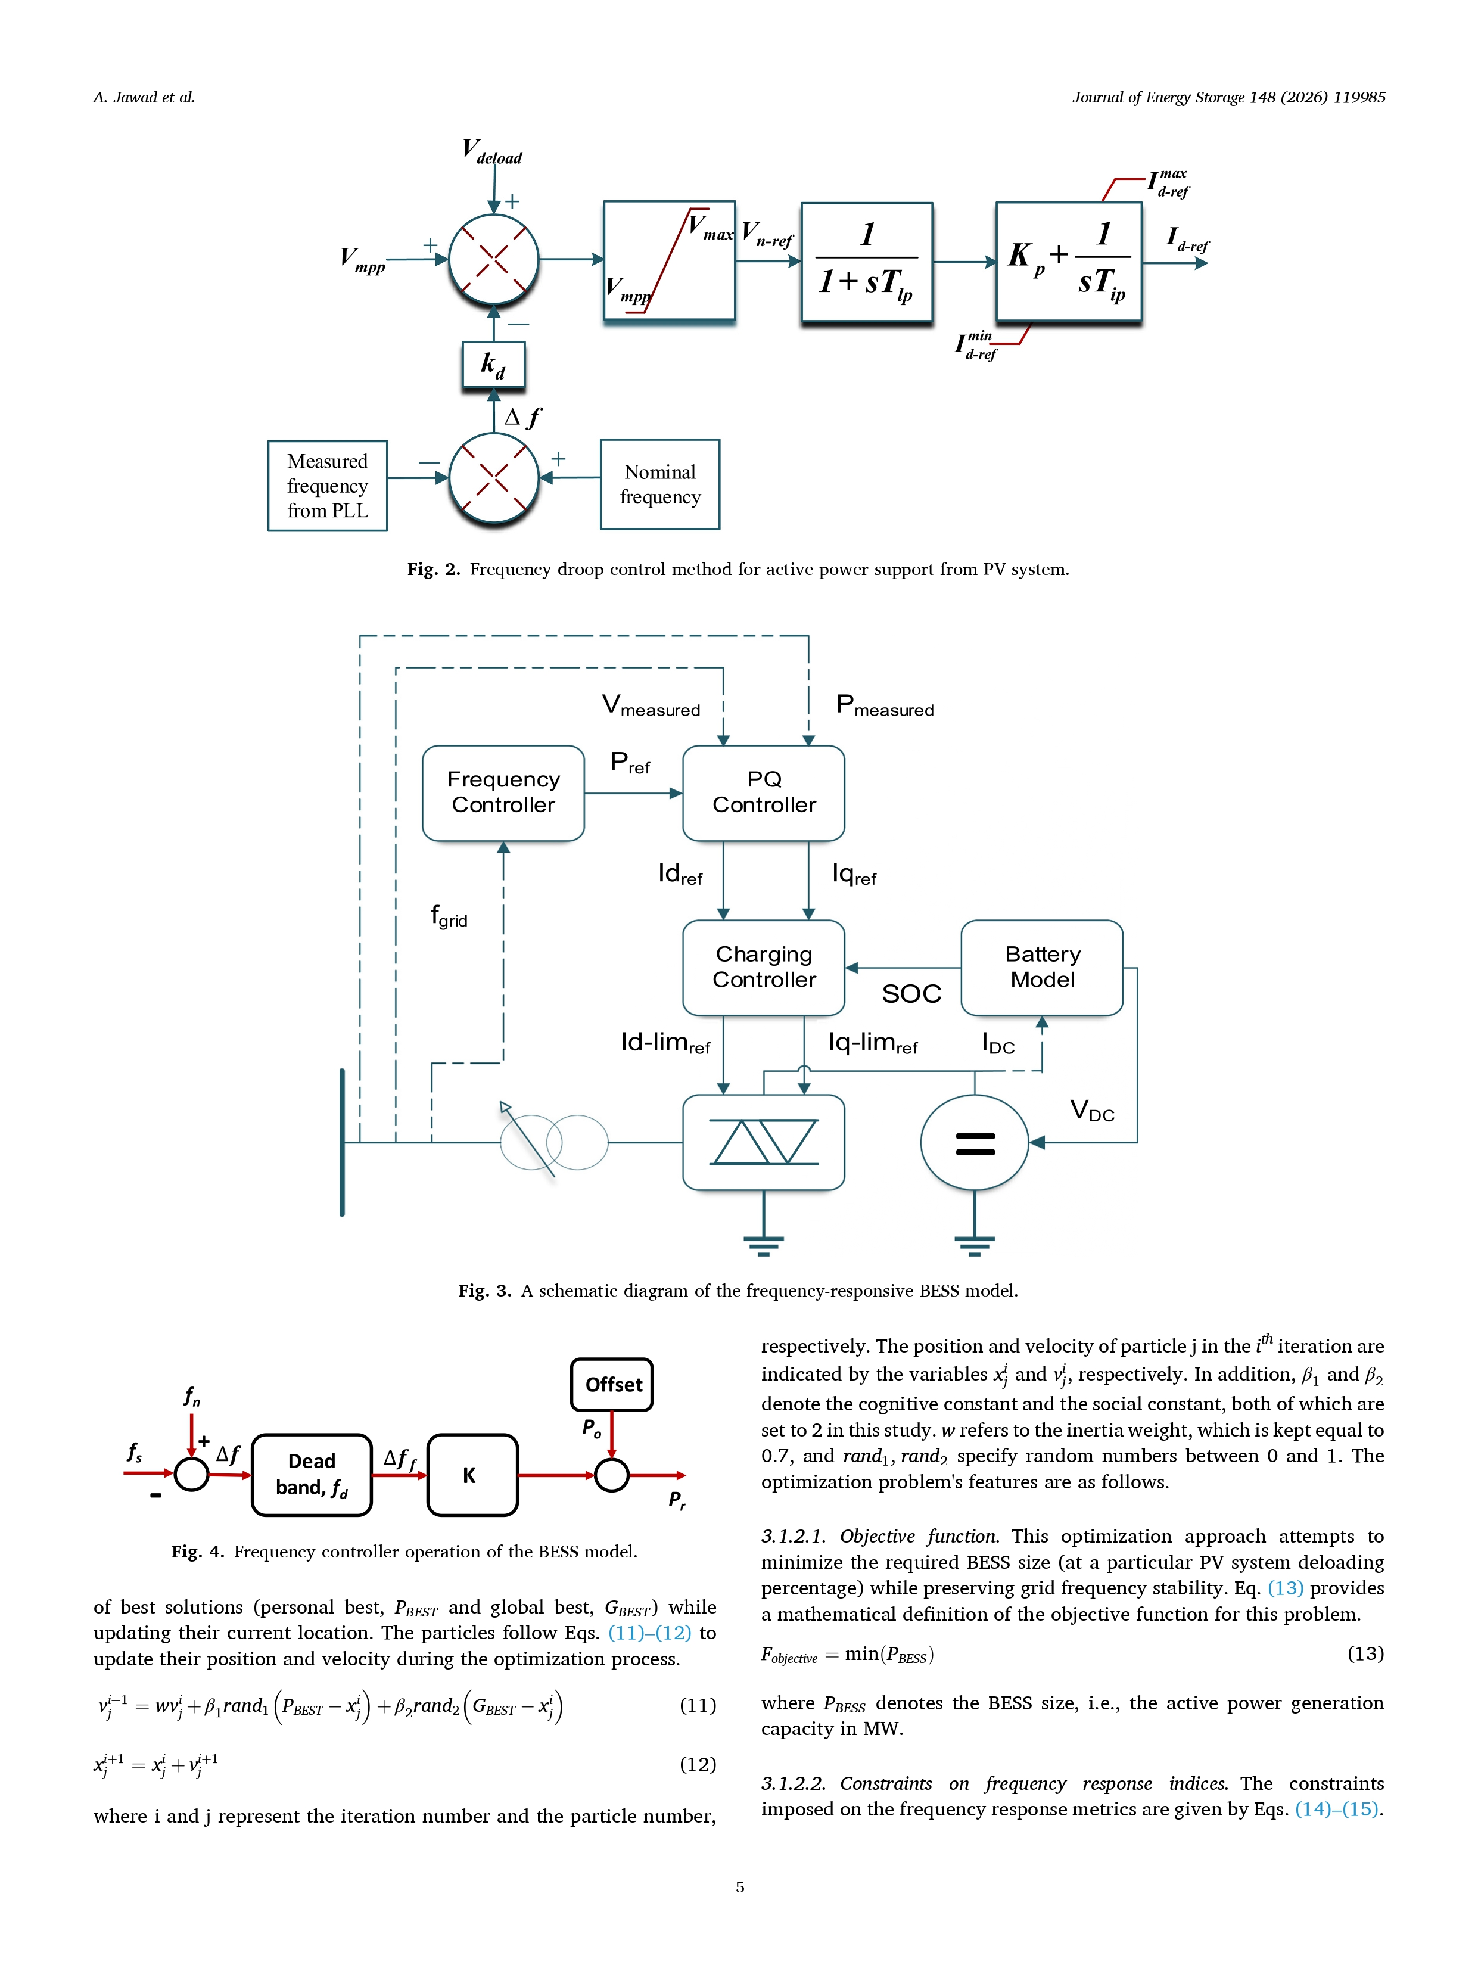
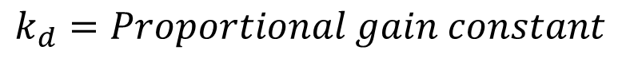
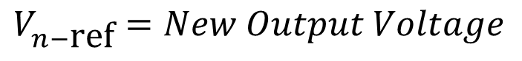
Deloaded PV System Modelling
$$V_{n−\text{ref}}=V_{\text{mpp}}+V_{\text{deload}}−k_{d}×Δf$$
$$V_{n−\text{ref}}=New Output Voltage$$
$$Δf=Signal proportional to frequency deviaton$$
$$k_{d}=Proportional gain constant$$
This rapid reaction is akin to the governor's response to SGs.
Fig. Deloaded operation mechanism of a PV system.
3

Slide 5
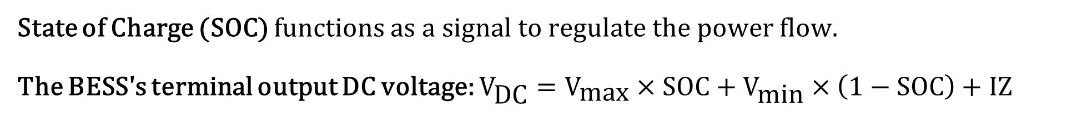
BESS Modelling for Frequency Support
BESS can store and provide reserved active power with a quick response time.
A total of three controllers are required to make the BESS frequency responsive.
Fig. A schematic diagram of the frequency-responsive BESS model.
State of Charge (SOC) functions as a signal to regulate the power flow.
The BESS's terminal output DC voltage: $V_{\text{DC}}=V_{\text{max}}×\text{SOC}+V_{\text{min}}×\left(1−\text{SOC}\right)+IZ$
4

Slide 6
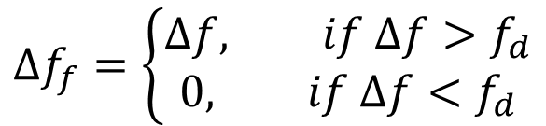
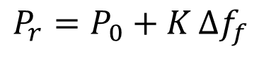
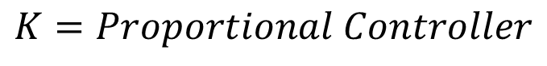
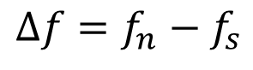
BESS Modelling for Frequency Support
Fig. Frequency controller operation of the BESS model.
$$Δf=f_{n}−f_{s}$$
$$Δf_{f}=\left\{\begin{aligned}Δf, if &Δf>f_{d} \\ 0, if Δf<f_{d}\end{aligned}\right.$$
$$Δf=Signal proportional to frequency deviaton$$
$$K=Proportional Controller$$
$$P_{r}=P_{0}+K Δf_{f}$$
5

Slide 7
Proposed Methodology
The proposed methodology is described in two key steps:
A functional relationship between varying deloaded PV sizes and corresponding optimal BESS is constructed.
The cost factor is taken into account in order to determine the optimum combination while giving each mechanism equal merit in terms of cost.
6

Slide 8
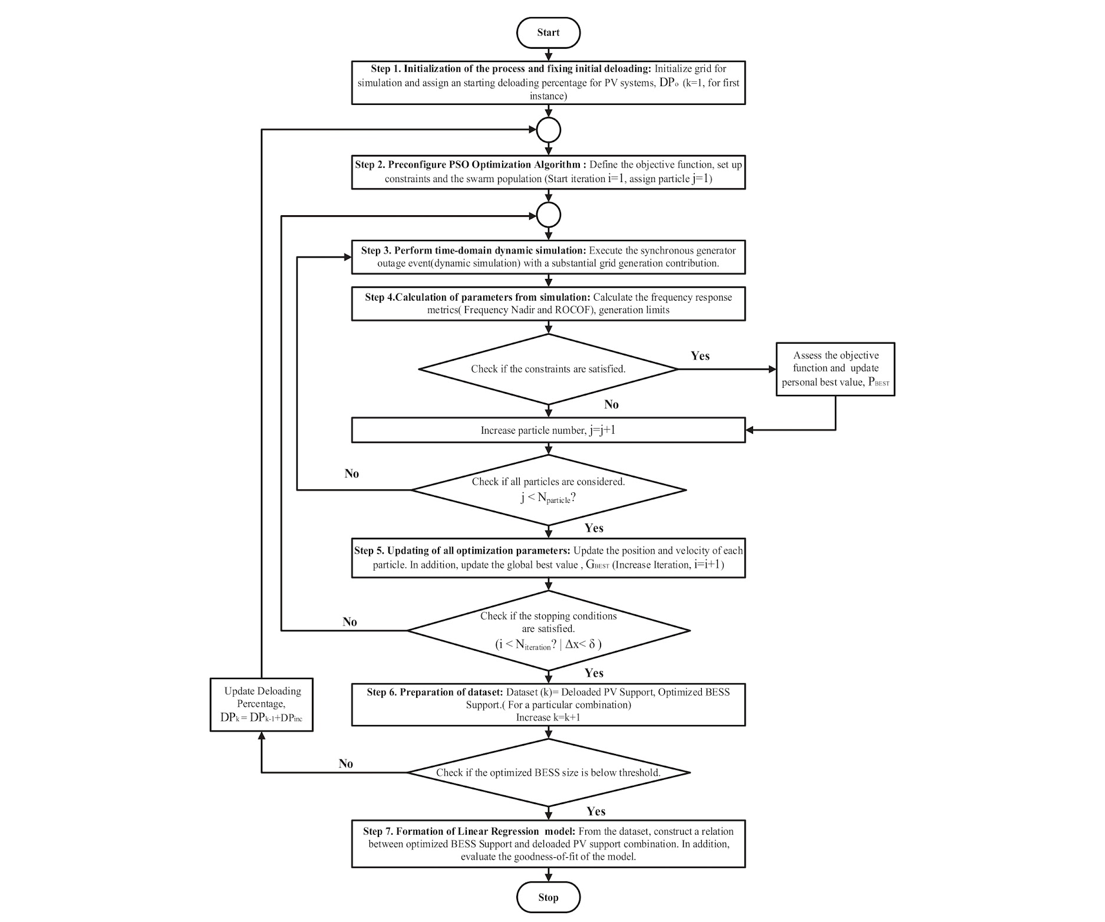
1024062304 Md. Nazmul Alam Munna
7

Slide 9

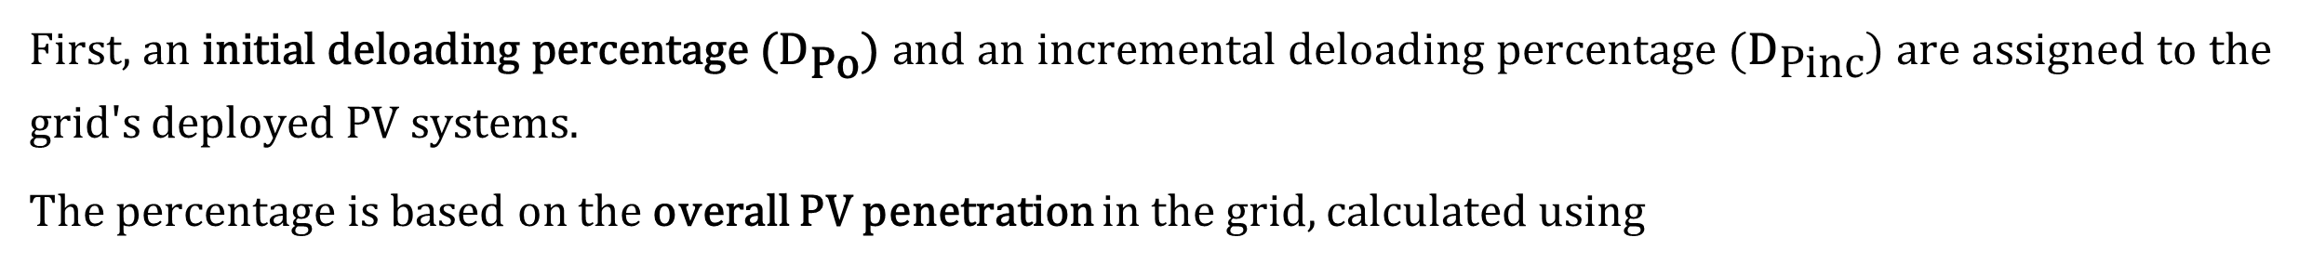
Step 1: Initialization of the process and fixing initial deloading
First, an initial deloading percentage (${\text{D}}_{\text{Po}}$) and an incremental deloading percentage (${\text{D}}_{\text{Pinc}}$) are assigned to the grid's deployed PV systems.
The percentage is based on the overall PV penetration in the grid, calculated using
${\%P}_{PV_total}=\frac{P_{PV_total}}{P_{total}}$×100%
Step 2: Preconfigure Particle Swarm Optimization (PSO) Algorithm Methodology
This optimization approach attempts to minimize the required BESS size.
$$F_{objective}=\min\left(P_{BESS}\right)$$
Maintaining power system balance results in a non-linear calculation in the optimization process. PSO is a comparatively simpler model that demonstrates efficient convergence towards the global optimum, enabling the methodology to achieve stable outcomes and maintain security at a lower cost per calculation.
A Python script is integrated with the DIgSILENT PowerFactory environment to deal with the power system's non-linearity and to implement the optimization.
8

Slide 10
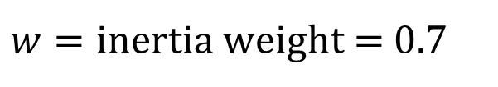
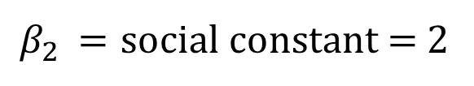
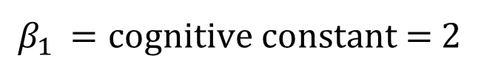
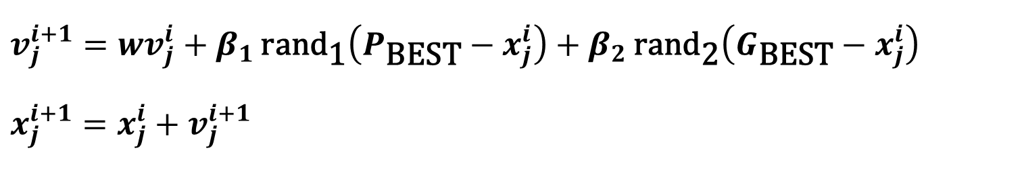
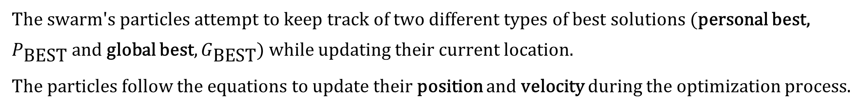
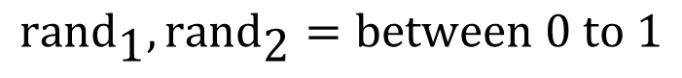
Particle Swarm Optimization (PSO) Algorithm Methodology
The swarm's particles attempt to keep track of two different types of best solutions (personal best, $P_{\text{BEST}}$ and global best, $G_{\text{BEST}}$) while updating their current location.
The particles follow the equations to update their position and velocity during the optimization process.
$$v_{j}^{i+1}=wv_{j}^{i}+β_{1} \text{ran}{\text{d}}_{\text{1}}\left(P_{\text{BEST}}−x_{j}^{i}\right)+β_{2} \text{ran}{\text{d}}_{\text{2}}\left(G_{\text{BEST}}−x_{j}^{i}\right)$$
$$x_{j}^{i+1}=x_{j}^{i}+v_{j}^{i+1}$$
$$i and j=iteration number and particle number$$
$β_{1} =\text{cognitive} \text{constant}$ = 2
$β_{2} =\text{social} \text{constant}$ = 2
$w=\text{inertia} \text{weight}$ = 0.7
$$\text{ran}{\text{d}}_{\text{1}},\text{ran}{\text{d}}_{\text{2}}=between 0 to 1$$
9

Slide 11
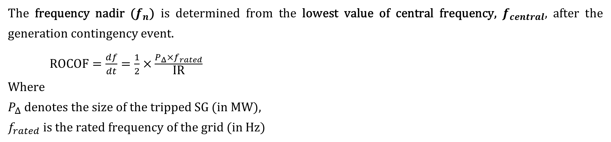
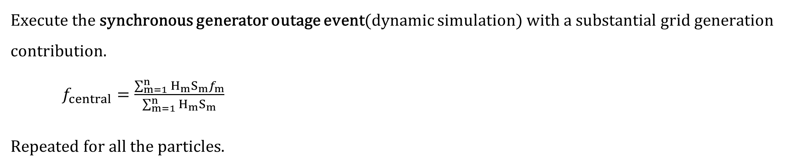
Step 3: Perform time-domain dynamic simulation
Execute the synchronous generator outage event(dynamic simulation) with a substantial grid generation contribution.
$f_{central}=\frac{\sum_{m=1}^{n}{H_{m}S_{m}f_{m}}}{\sum_{m=1}^{n}{H_{m}S_{m}}}$
Repeated for all the particles.
Step 4: Calculation of simulation parameters
The frequency nadir ($f_{n}$) is determined from the lowest value of central frequency, $f_{central}$, after the generation contingency event.
$\text{ROCOF}=\frac{df}{dt}=\frac{1}{2}×\frac{P_{Δ}×f_{rated}}{\text{IR}}$
Where
$P_{Δ}$ denotes the size of the tripped SG (in MW),
$f_{rated}$ is the rated frequency of the grid (in Hz)
10

Slide 12
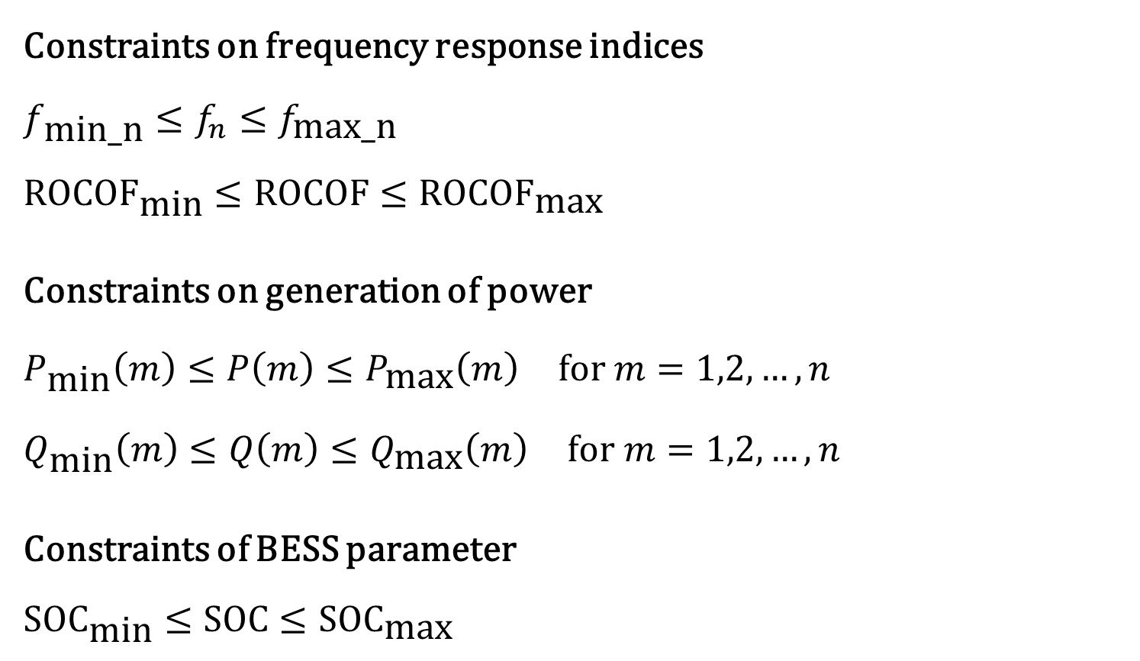
Constraints
Constraints on frequency response indices
$$f_{\text{min}\text{_}\text{n}}≤f_{n}≤f_{\text{max}\text{_}\text{n}}$$
$$\text{ROCO}{\text{F}}_{\text{min}}≤\text{ROCOF}≤\text{ROCO}{\text{F}}_{\text{max}}$$
Constraints on generation of power
$$P_{\text{min}}\left(m\right)≤P\left(m\right)≤P_{\text{max}}\left(m\right) \text{for} m=1,2,…,n$$
$$Q_{\text{min}}\left(m\right)≤Q\left(m\right)≤Q_{\text{max}}\left(m\right) \text{for} m=1,2,…,n$$
Constraints of BESS parameter
$$\text{SO}{\text{C}}_{\text{min}}≤\text{SOC}≤\text{SO}{\text{C}}_{\text{max}}$$
11

Slide 13
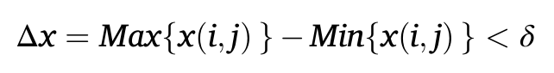
1024062304 Md. Nazmul Alam Munna
12

Slide 14
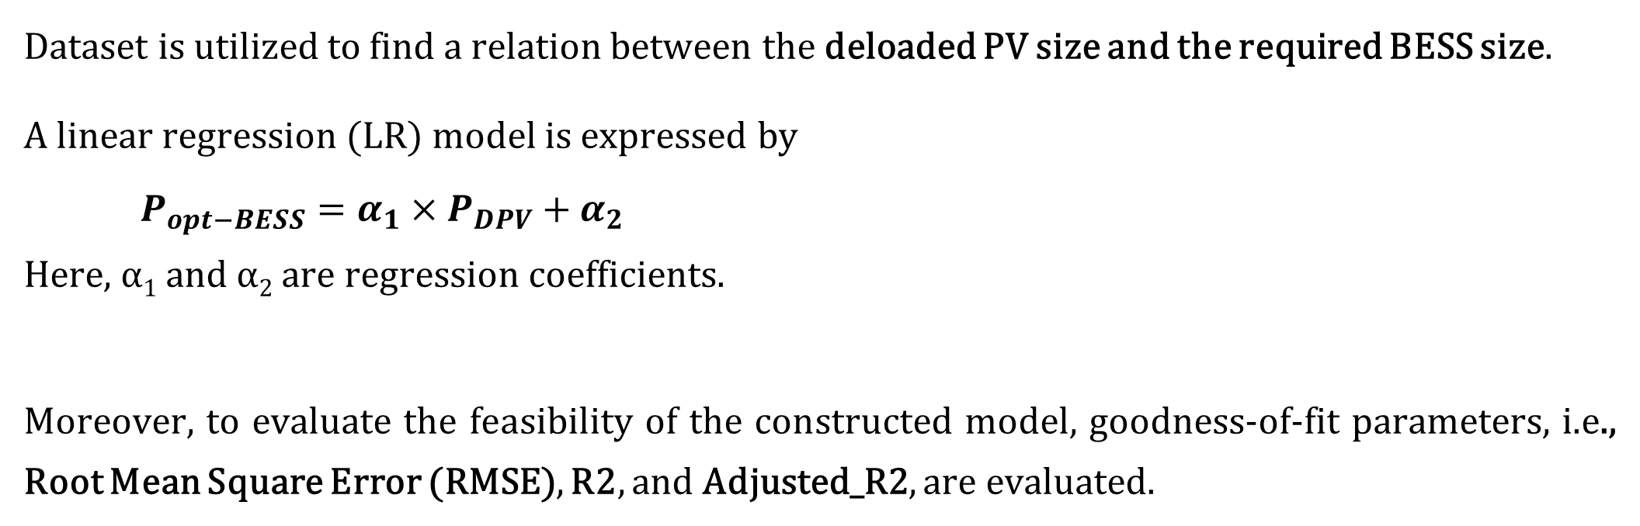
Step 7: Formation of Linear Regression (LR) model
Dataset is utilized to find a relation between the deloaded PV size and the required BESS size.
A linear regression (LR) model is expressed by
$P_{opt−BESS}=α_{1}×P_{DPV}+α_{2}$
Here, α₁ and α₂ are regression coefficients.
Moreover, to evaluate the feasibility of the constructed model, goodness-of-fit parameters, i.e., Root Mean Square Error (RMSE), R2, and Adjusted_R2, are evaluated.
13

Slide 15
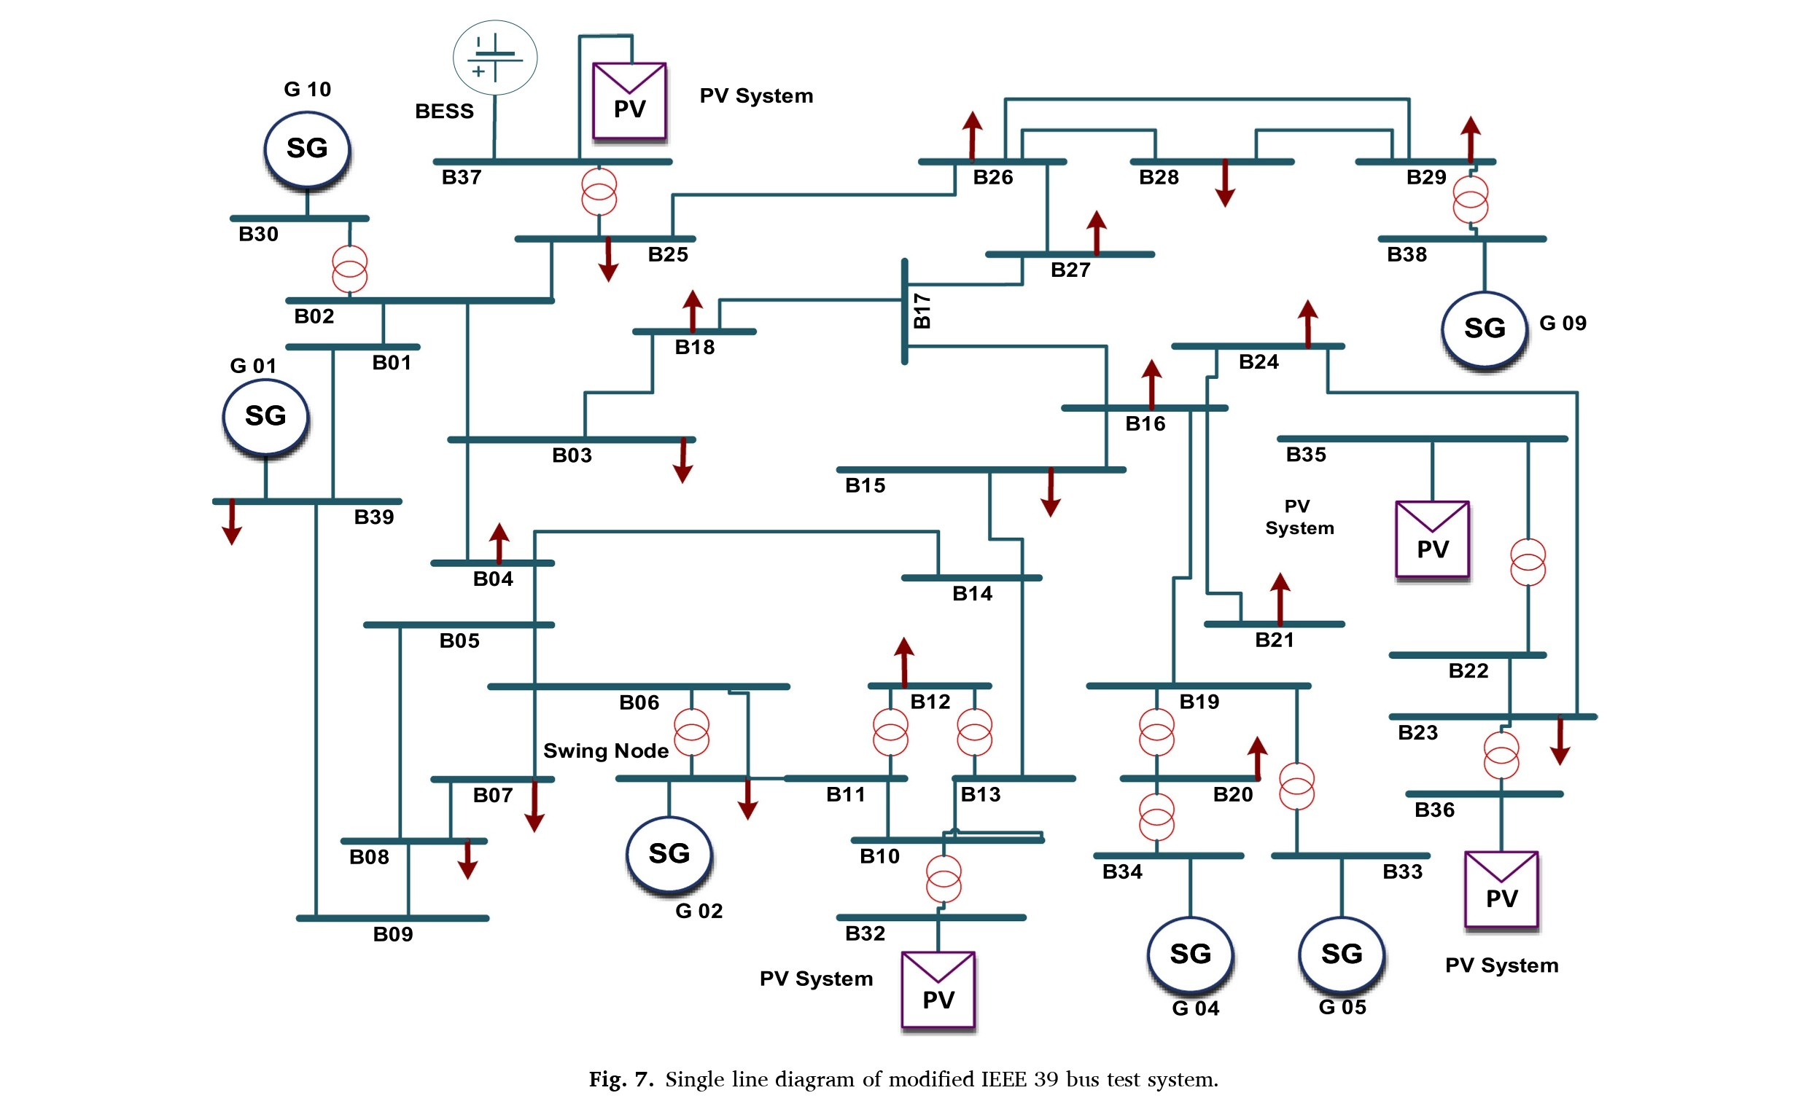
Simulation scenarios
14

Slide 16
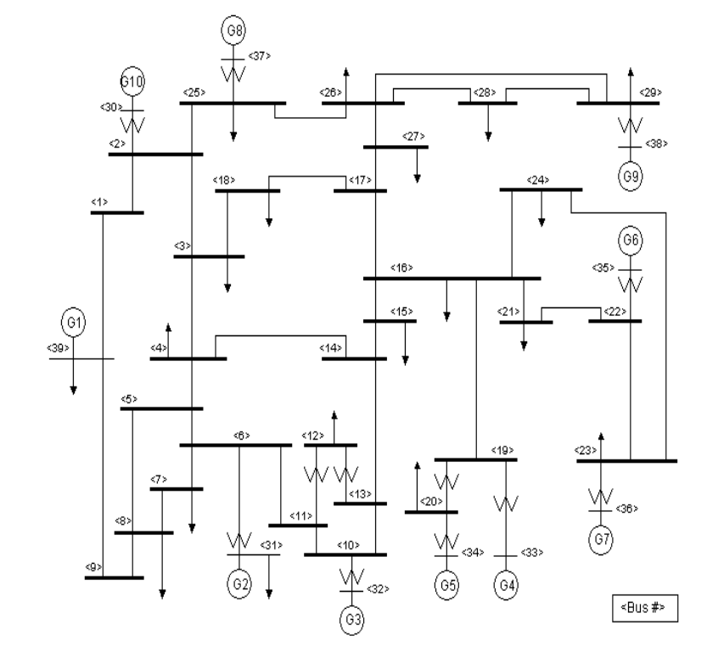
Simulation scenarios
Fig. IEEE 10 Generator 39 Bus System.
15

Slide 17
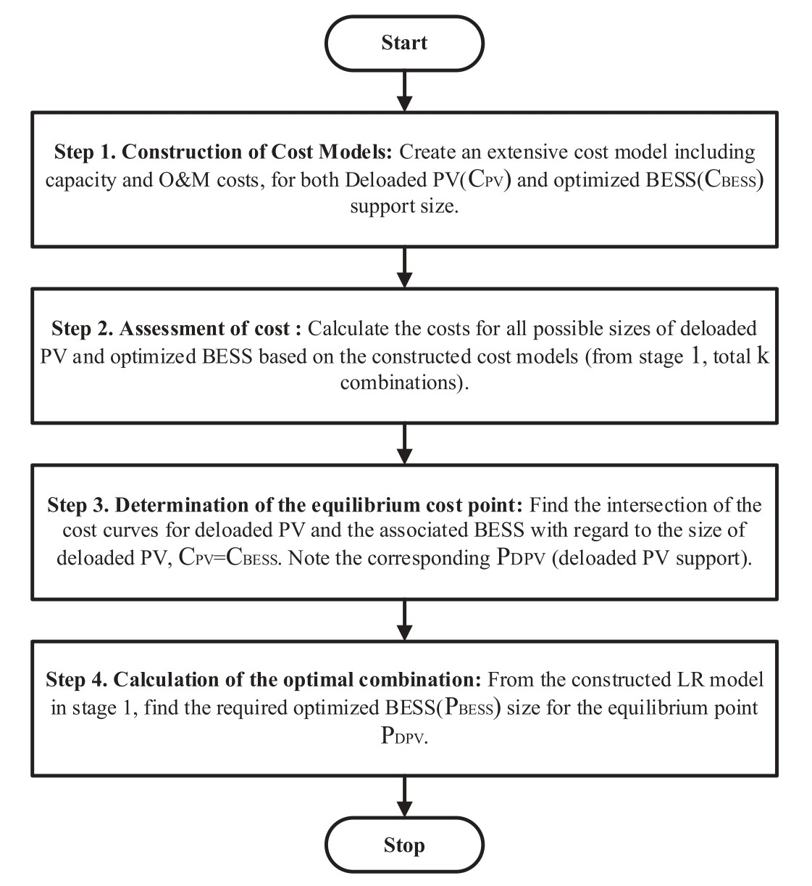
Cost Factor Optimization
16

Slide 18
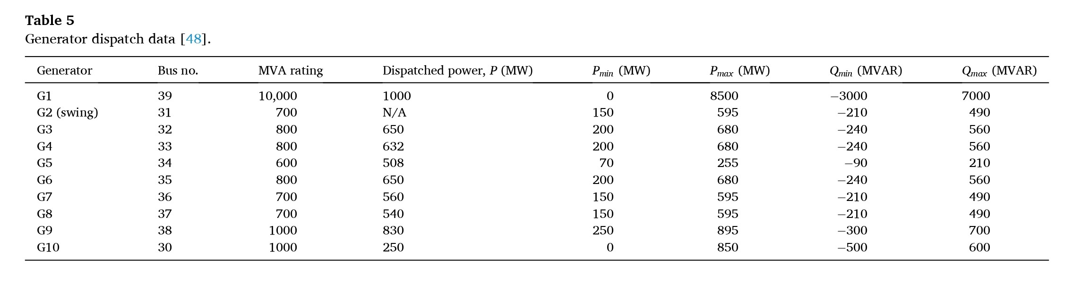
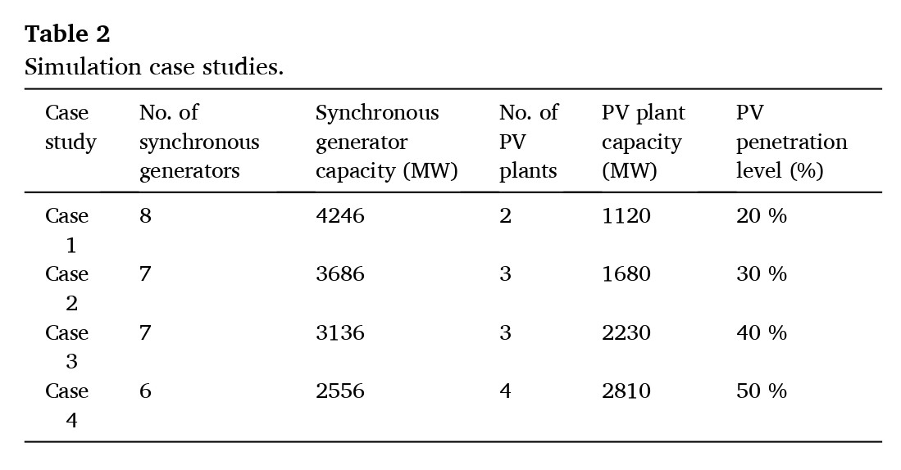
Simulation scenarios
17

Slide 19
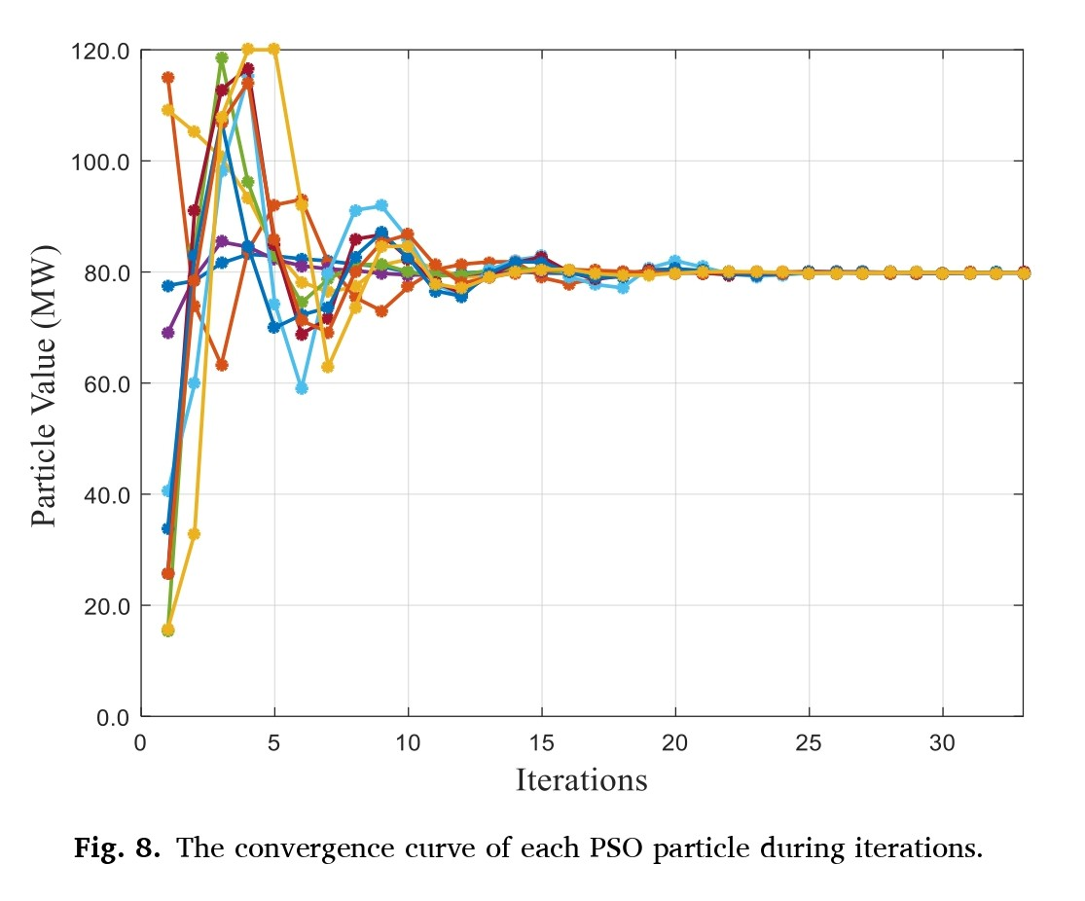
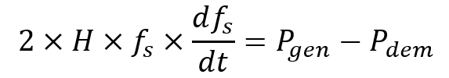
Iterations for Initial Deloading
Particles start to move on the solution space at first in a random manner. Then, for each iteration, their values are updated, and the particles begin to converge towards the optimum solution.
Power mismatch can be formulated by the swing equation as follows
When an outage event is initiated, the first derivative of the frequency become a non-zero quantity. This results in system frequency deviation and the subsequent proportionate activation of the installed support techniques, causing a linear variation in the optimal dispatch of both mechanisms.
18

Slide 20
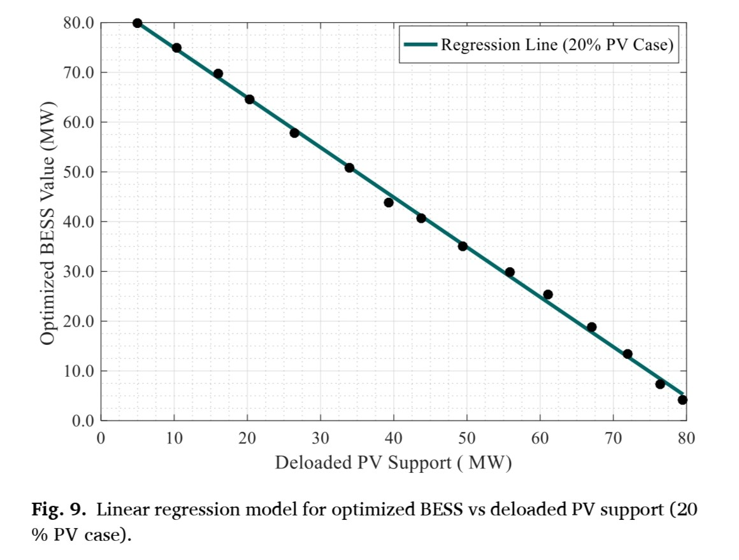
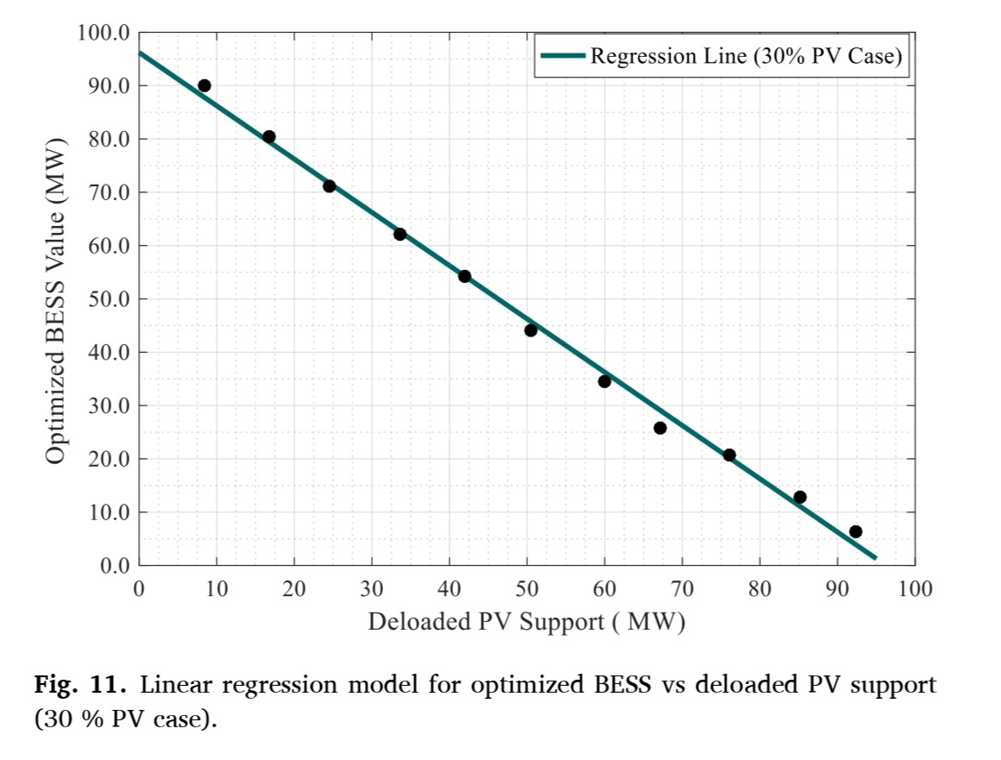
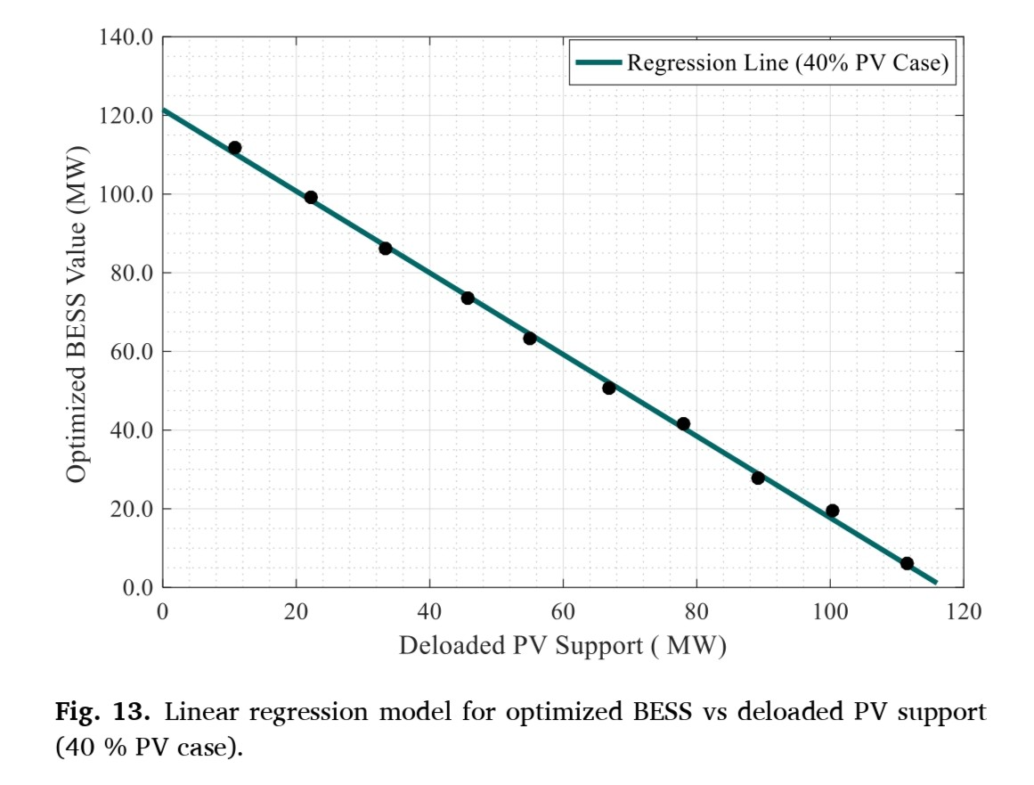
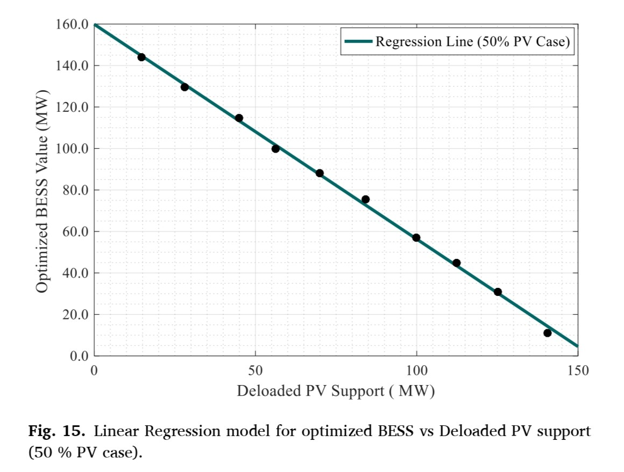
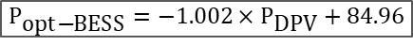

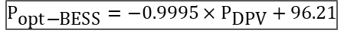
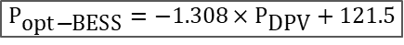
LR Model
$$P_{\text{opt}\text{−}\text{BESS}}=−1.002×P_{\text{DPV}}+84.96$$
$$P_{\text{opt}\text{−}\text{BESS}}=−0.9995×P_{\text{DPV}}+96.21$$
$$P_{\text{opt}\text{−}\text{BESS}}=−1.308×P_{\text{DPV}}+121.5$$
$$P_{\text{opt}\text{−}\text{BESS}}=−1.036×P_{\text{DPV}}+159.9$$
19

Slide 21
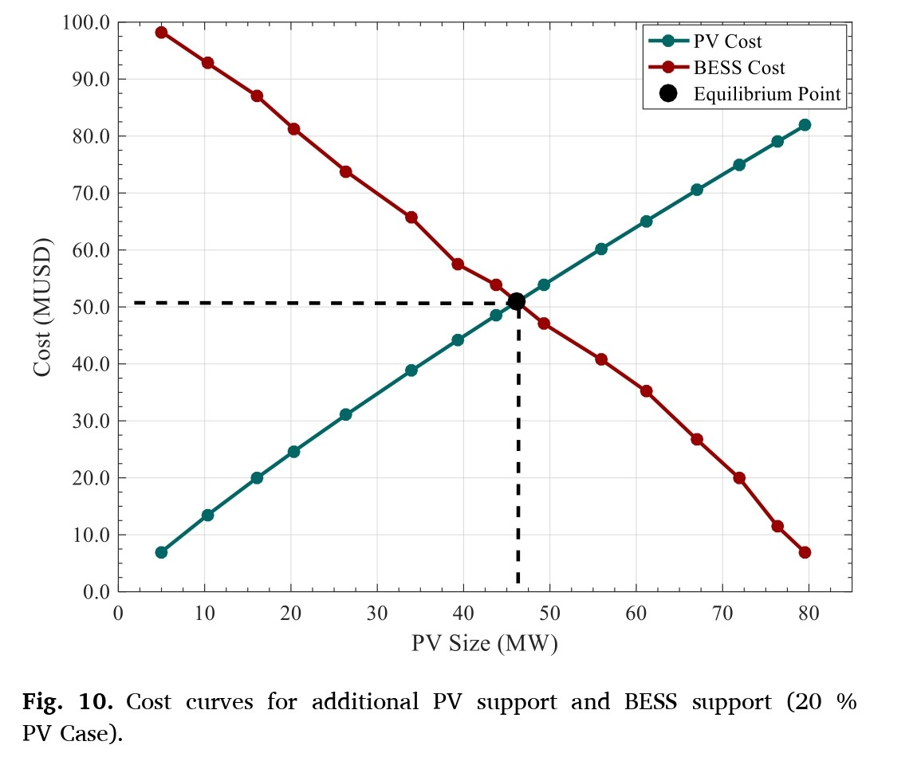
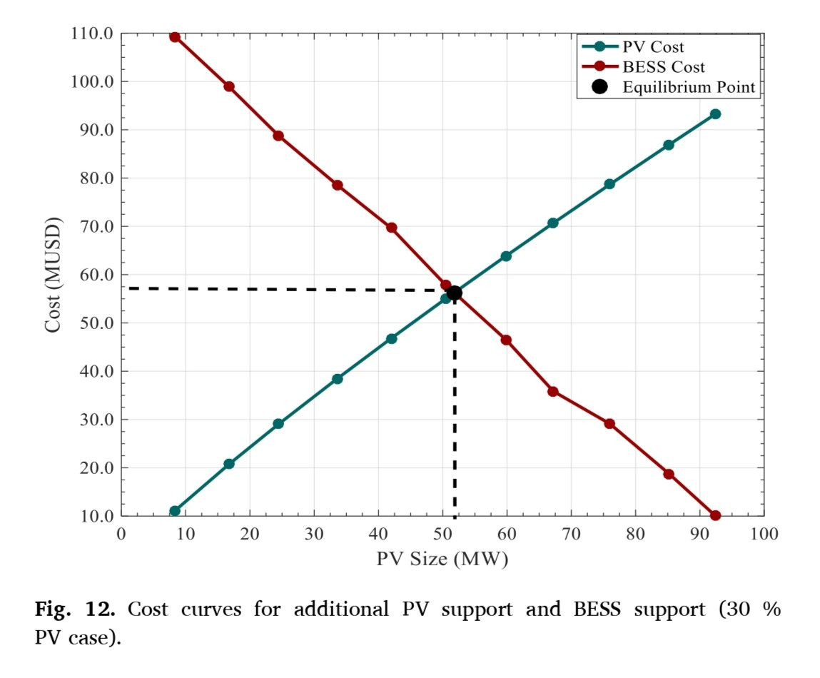
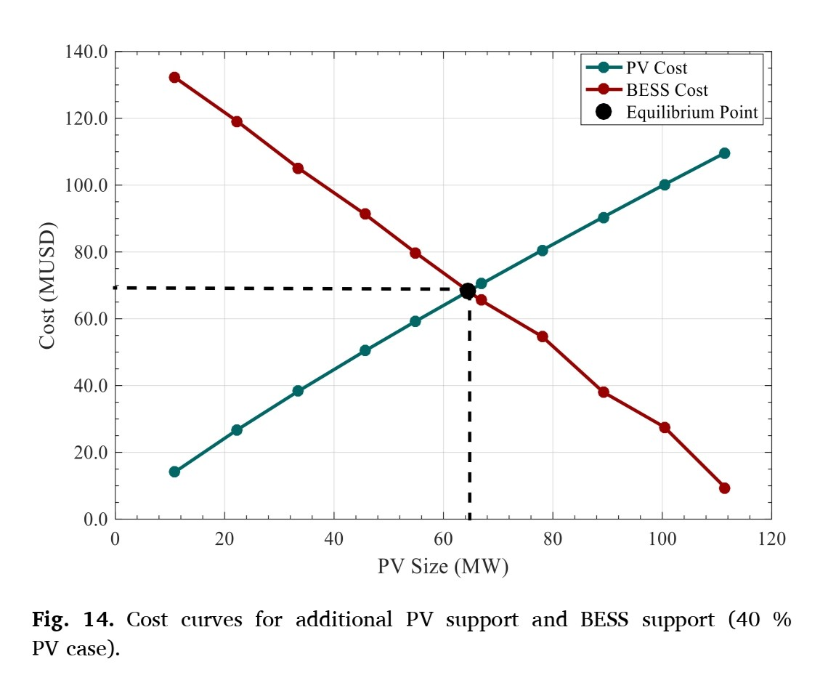
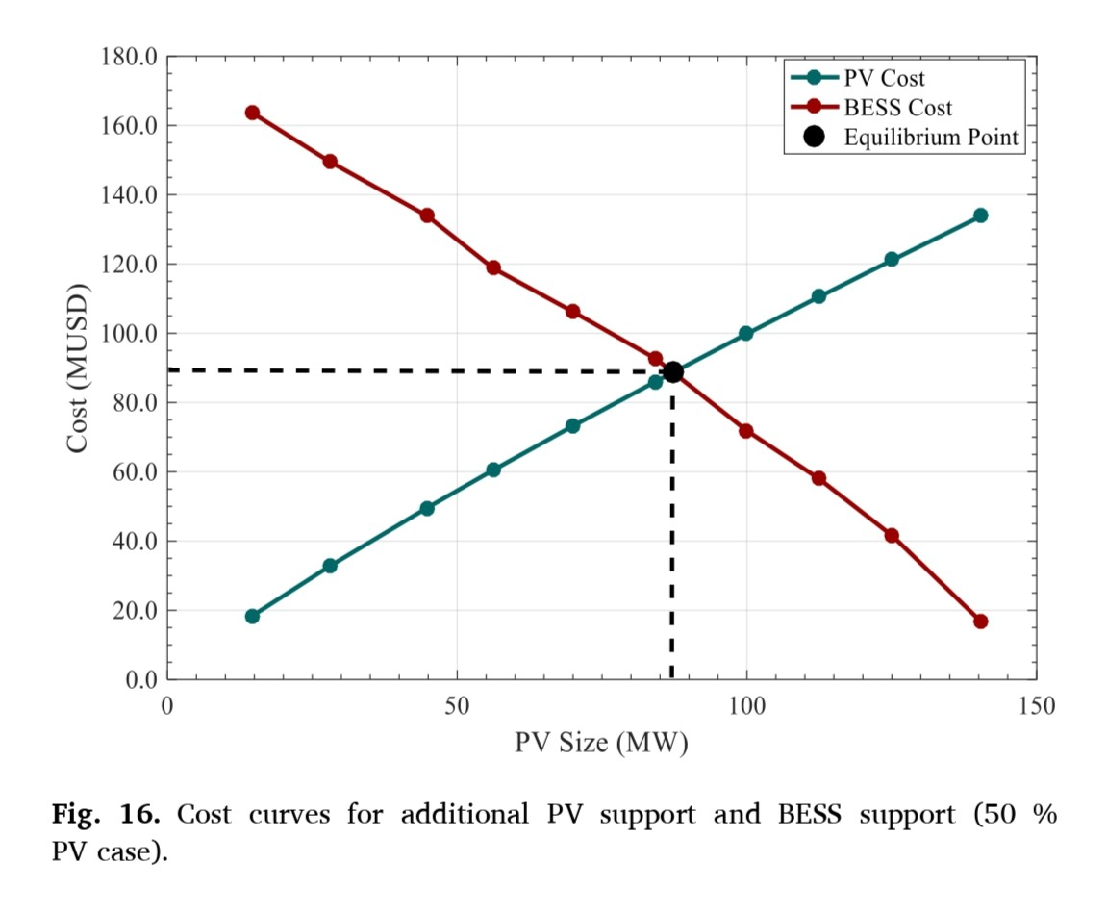
Equilibrium Point Combination
20

Slide 22
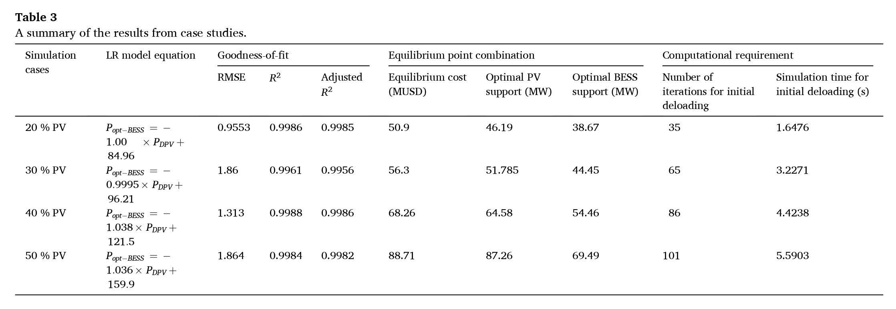
Summary
The equilibrium point of cost differs for different PV penetration levels because higher PV integration increases grid vulnerability to frequency instability, requiring progressively larger investments in both deloaded PV and Battery Energy Storage Systems (BESS) to maintain grid stability.
21

Slide 23
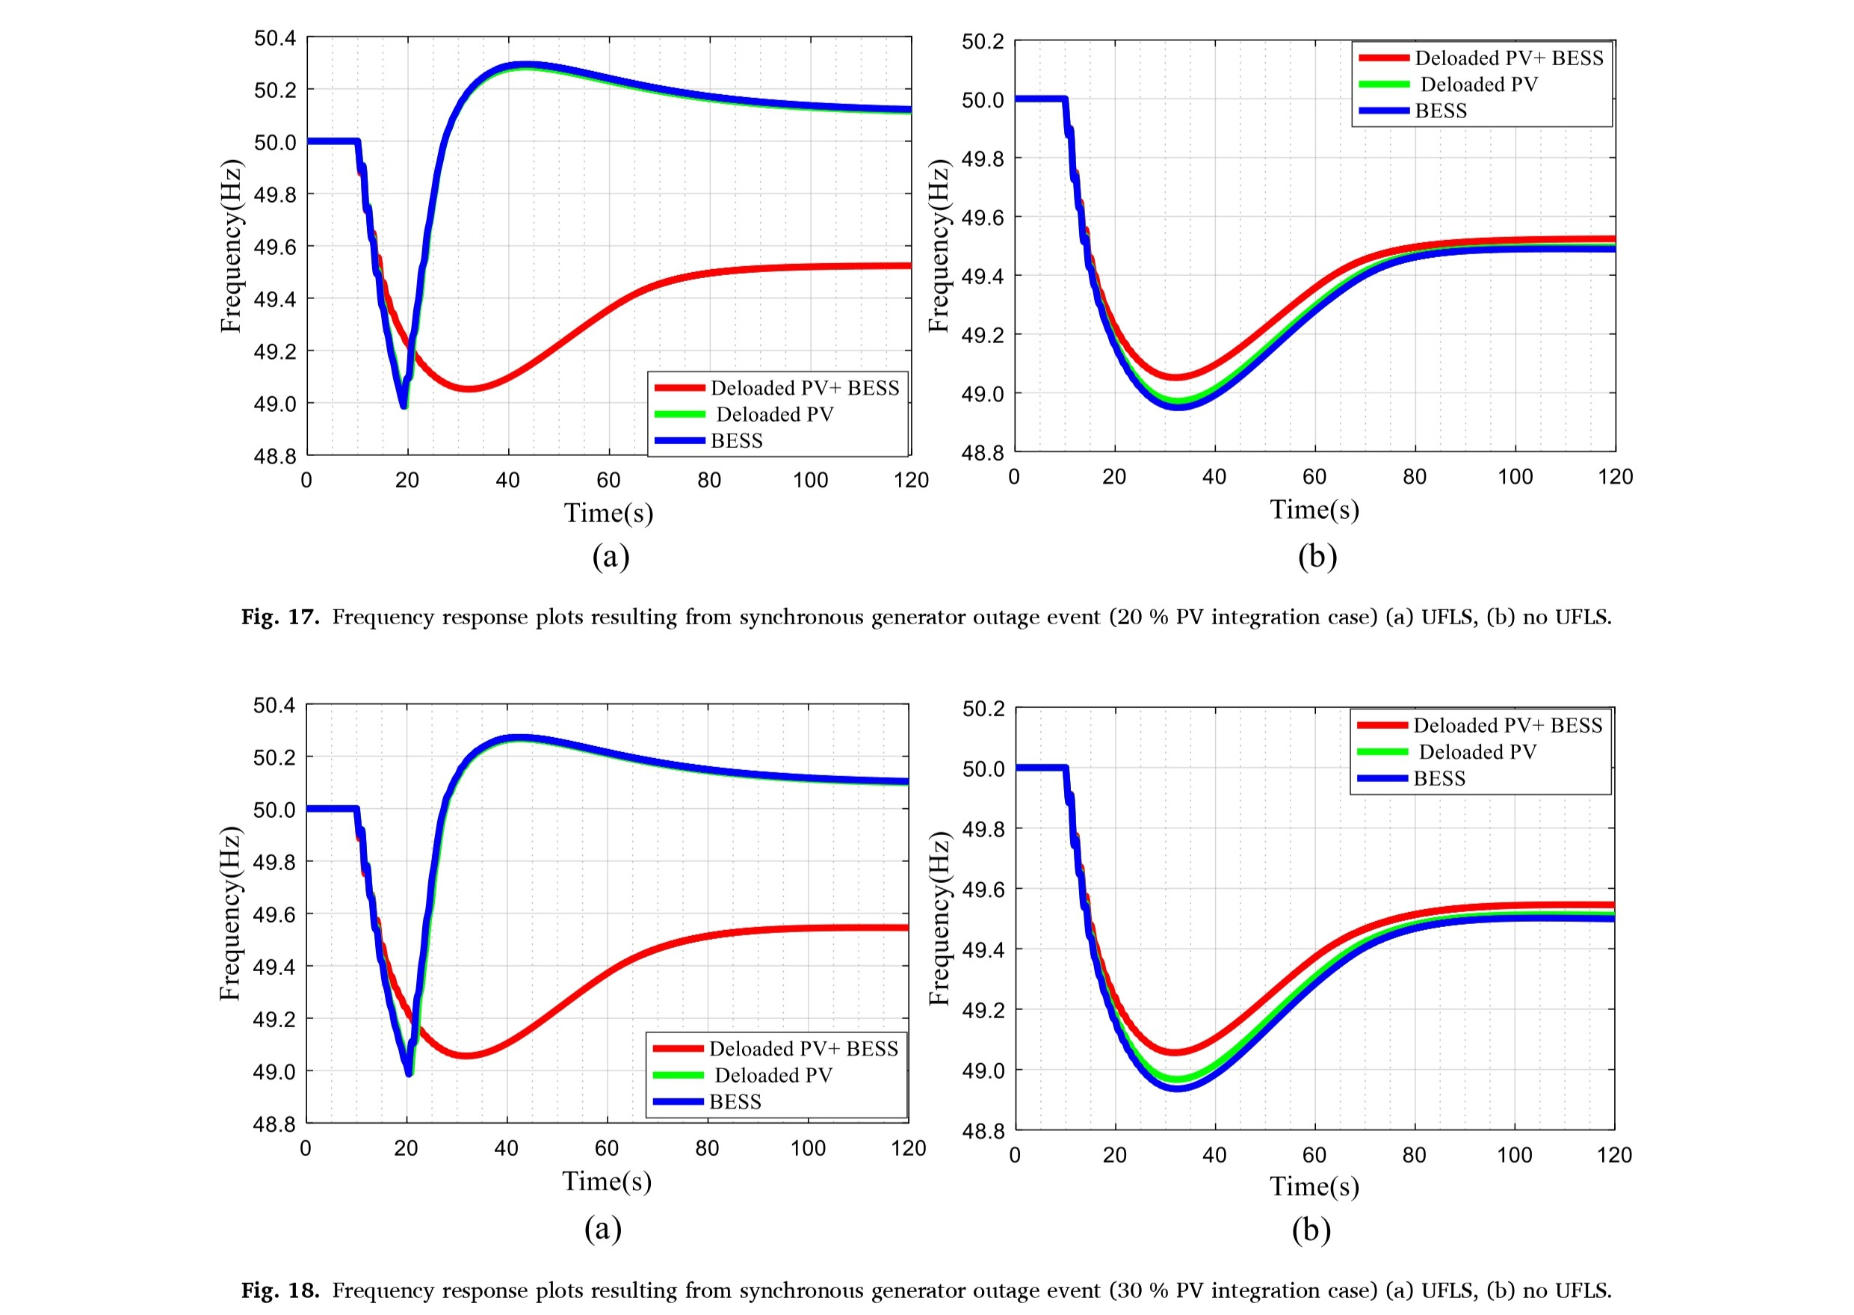
Performance Analysis
22

Slide 24
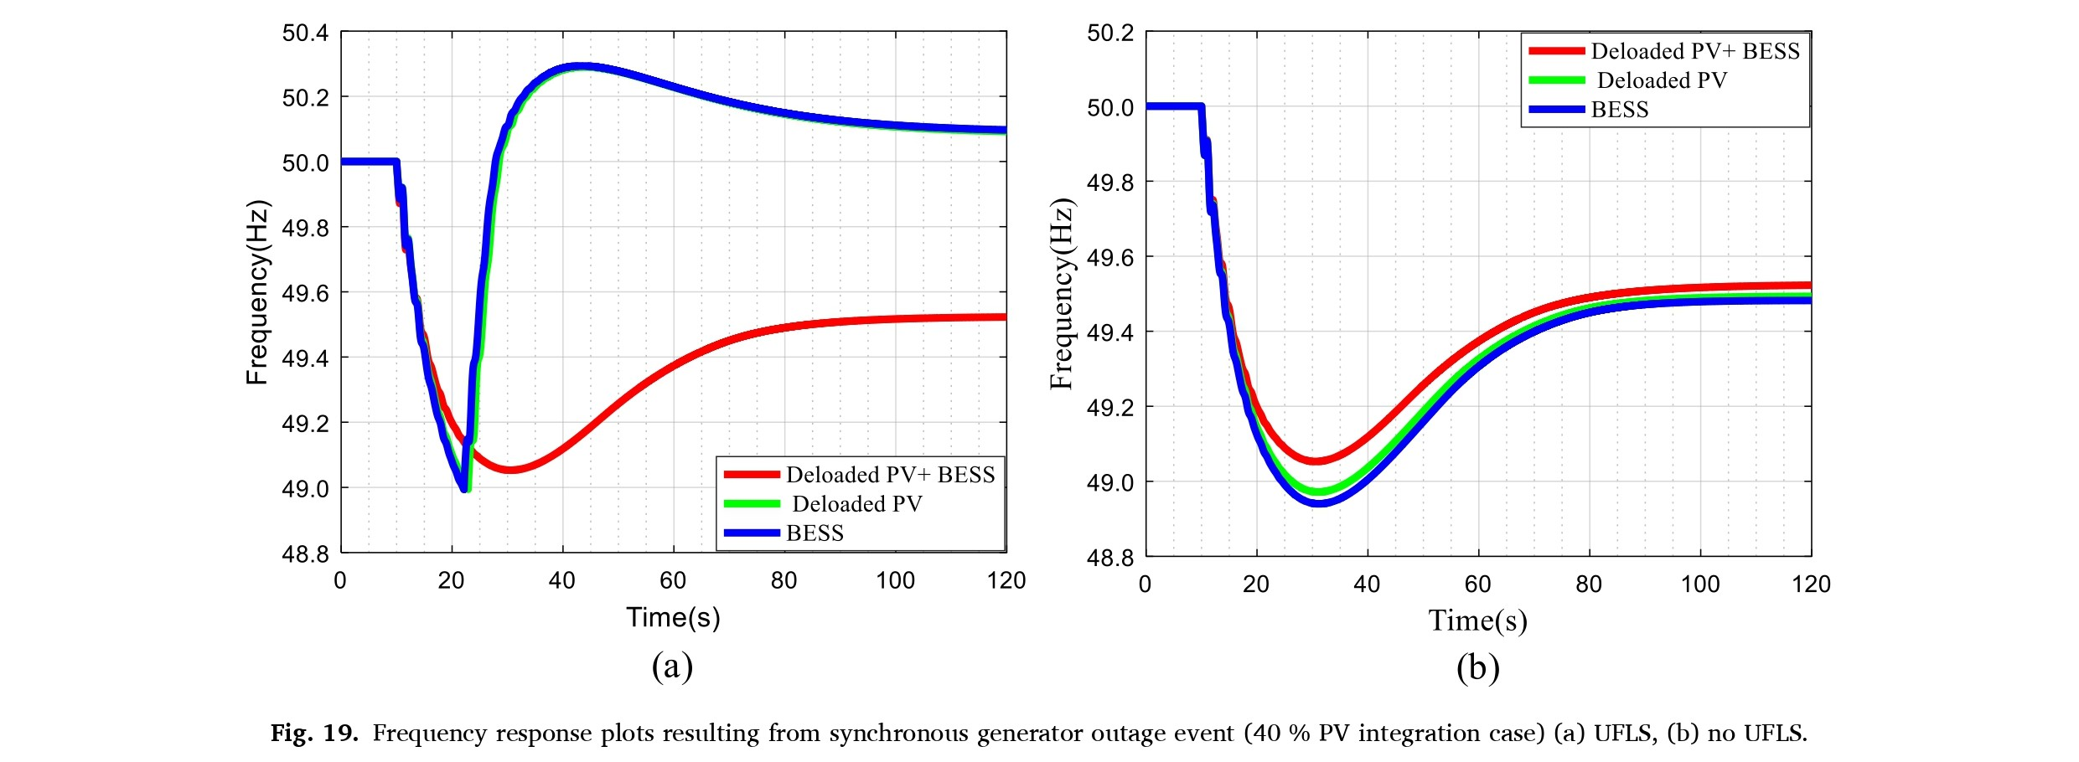
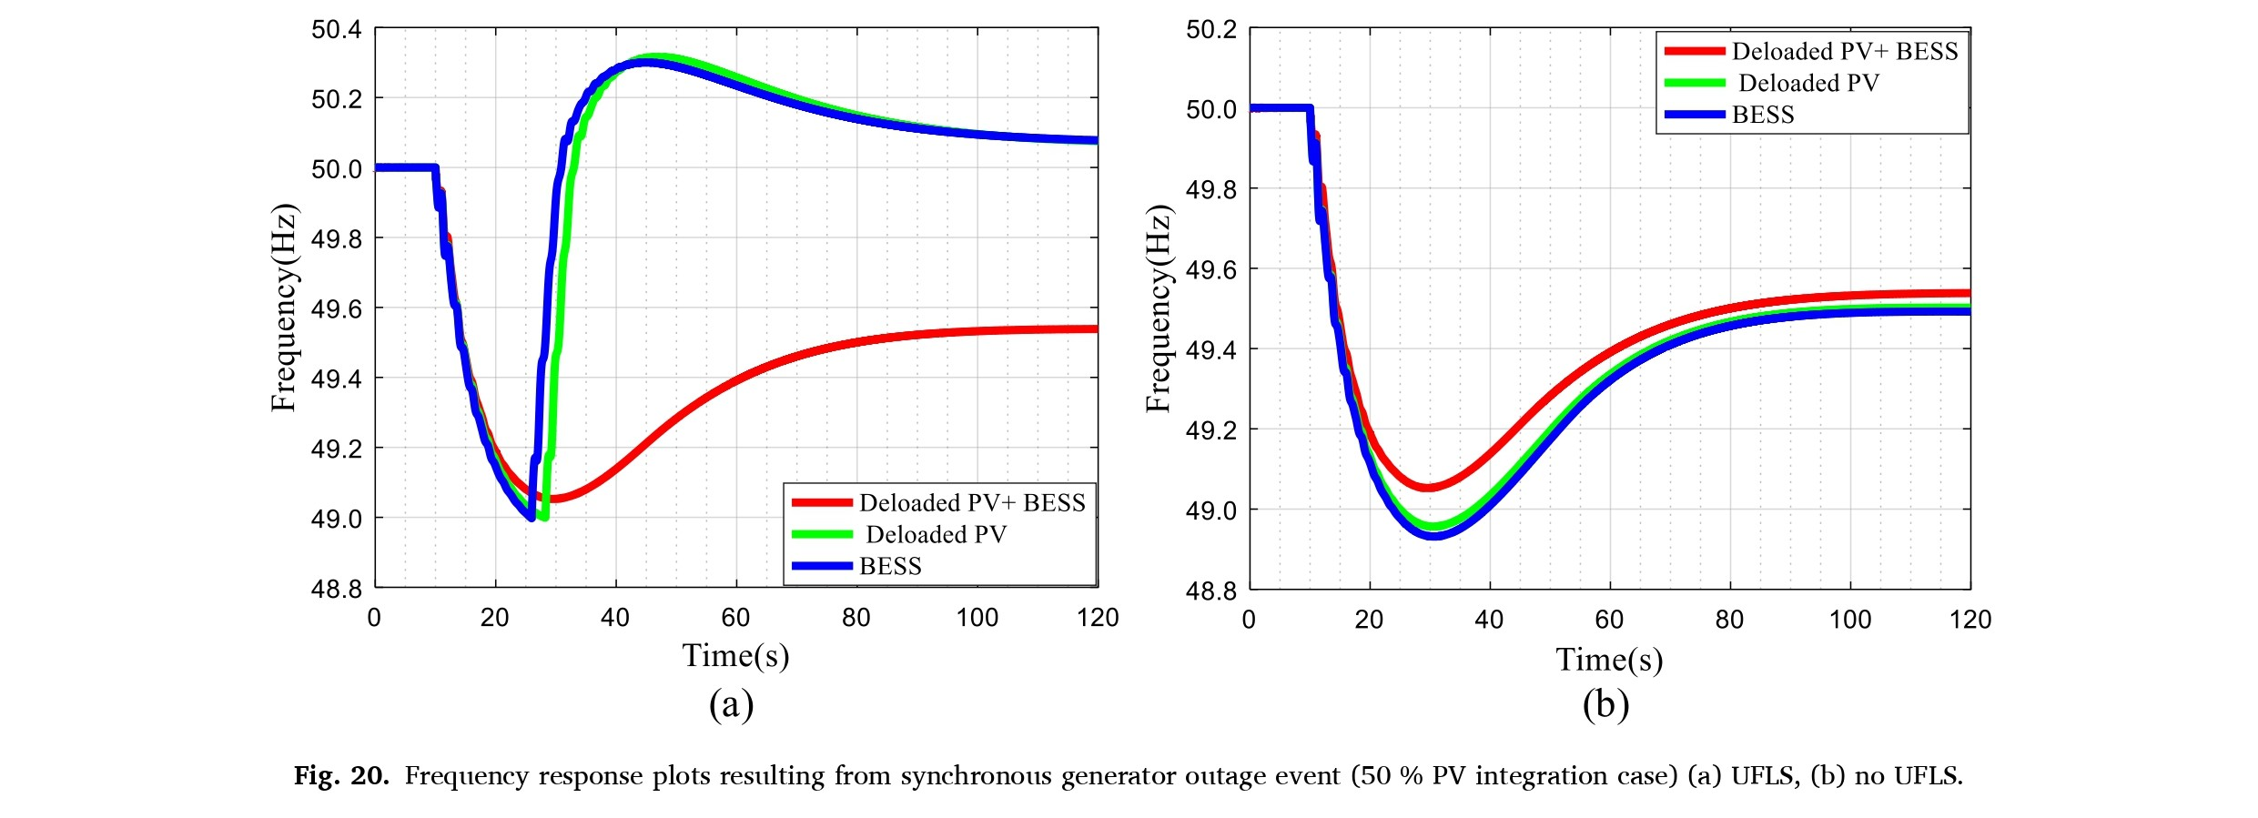
Performance Analysis
23

Slide 25
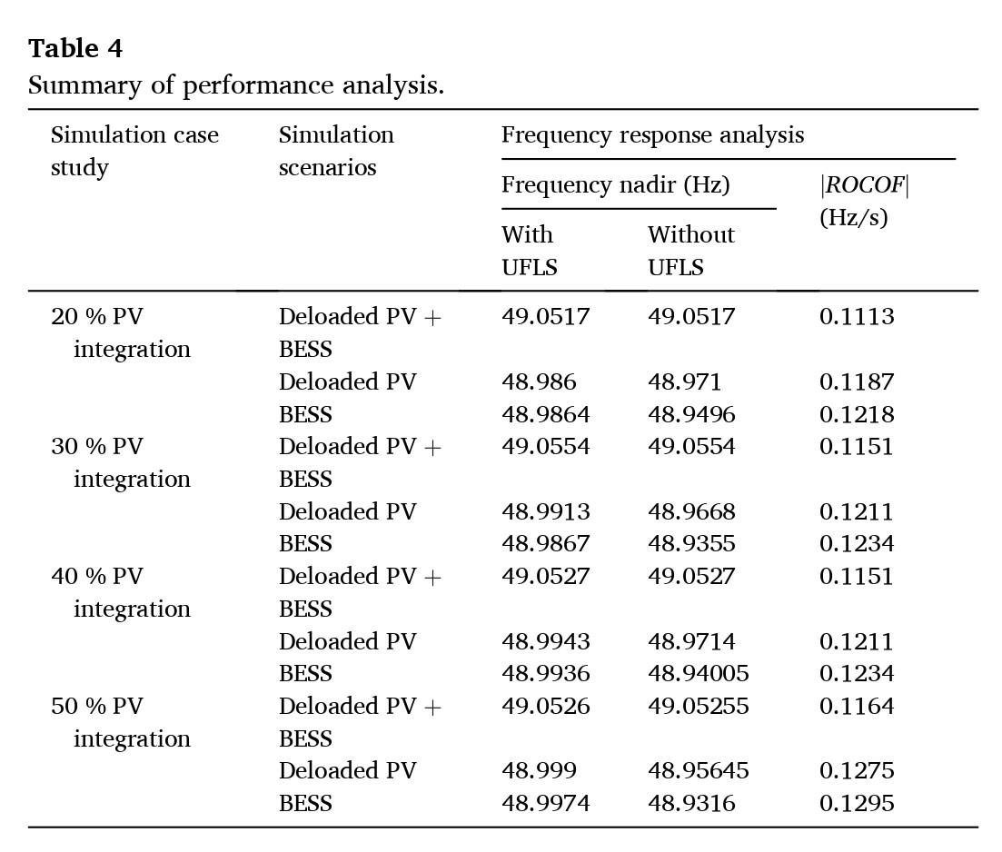
Performance Analysis
24

Slide 26
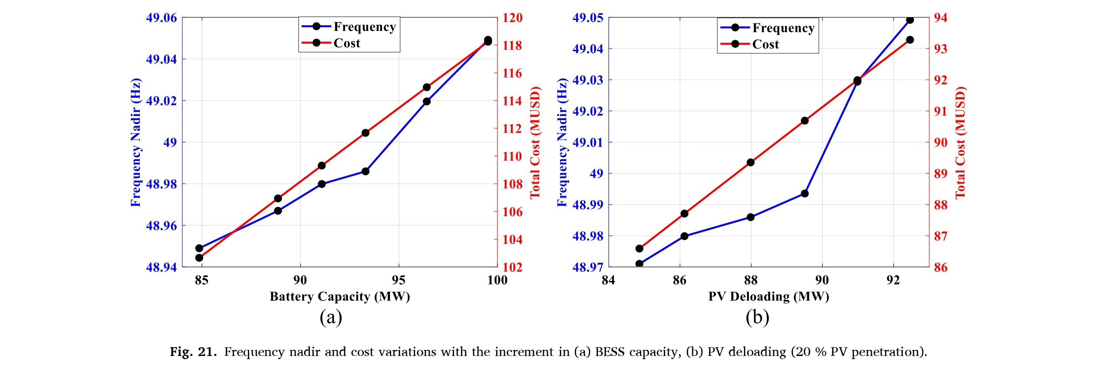

Cost Variation
25

Slide 27
Limitations
Supplementary Control in Frequency Regulation is not considered.
No definite guarantee of reaching the global optimum using PSO due to non-linear constraints.
Applicability under Very Low or High Penetration Percentages.
Impact of Weather Parameters is not considered.
26

Slide 28

October 2024 Semester

